Slide 1
DATA 601 – Lecture 14 Make, Git, Ethics…
Dr. Ergun Simsek

Slide 2
MAKE
Part I
I'm gonna him an offer he can't refuse.

Slide 3
Make
Make is a versatile tool which can run commands
Some examples
Compile source code into executable programs or libraries
Run scripts on data files to get summaries or plots
Parse and combine text files and plots to create paper
Make is designed so as to only update files when they need to be. It tracks the dependencies between files it creates and files used to create them.
Read
Output
Process

Slide 4
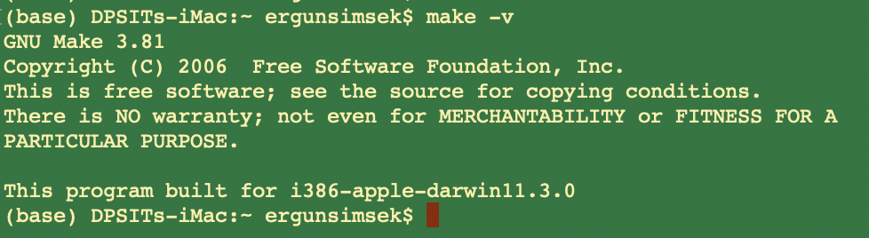
Setup
Make is already available in Unix machines
On Macs, make comes with Xcode
For Windows, I have no clue
https://github.com/swcarpentry/windows-installer
Open a terminal and check whether you have it
make -v

Slide 5
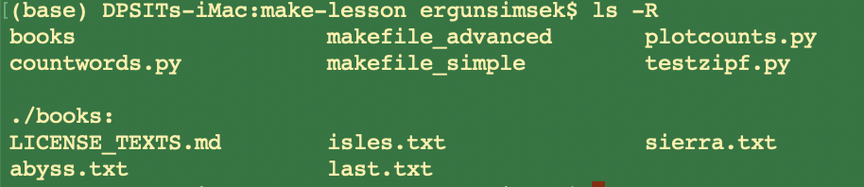
Example
Let’s look at our folder
We have 3 *.py codes
We have a subfolder called “books” which has some *.txt files

Slide 6
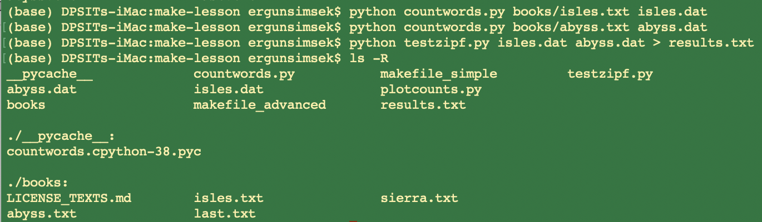
Example
The Python program “countwords.py” counts the frequency of each word in a text file.
We can out the frequency of words in “x.txt” to a new data file “x.dat”
Then we can use the “testzipf.py” to test the “Zipf’s Law” on the “x.dat”
In a terminal, we can
achieve this in 3 steps
Notes:
Zipf’s Law: the frequency of any word is inversely proportional to its rank in the frequency table. Thus the most frequent word will occur approximately twice as often as the second most frequent word, three times as often as the third most frequent word, etc.

Slide 7
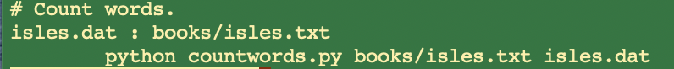
Example Cont.
We can create a Makefile to automate processing of the texts.
Let us create a new file called “makefile” (no extension) with the following content:
target and dependency are separated by :
“#” denotes a comment
dependency
target
ACTION
tab
(not 8 spaces)
dependency
target
To take action, simply enter “make” in the terminal

Slide 8
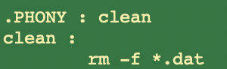
Phony Targets
Suppose we want to remove all our data files *.dat.
We can introduce a new target “clean,” and associated cleaning rule, to the end of our Makefile.
Here, the target “clean” is “.PHONY” in the sense that it doesn’t refer to a file.
-f: ignore non-existing files

Slide 9
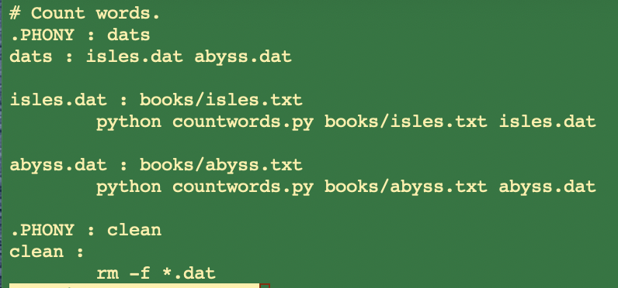
Multiple Targets
As the Makefile gets larger, there may be a variety of data file targets that we would like to be able to build all at once.
One way of doing this would be with a phony target “dats” which depends on all of the targets we want to build.
Let’s put the following at the beginning of the Makefile so that it is the default target.

Slide 10
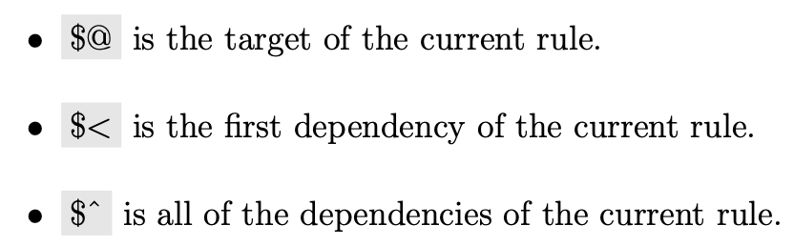
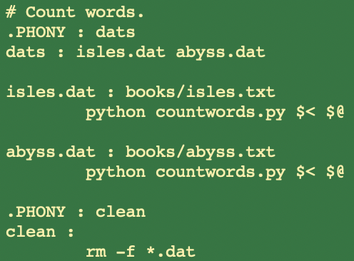
Automation (Step 1)
Automatic variables are reserved expressions for targets and dependencies to be used within rules.

Slide 11
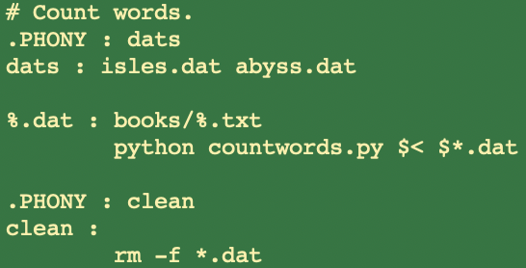
Automation (Step 2: Pattern Rules)
Our Makefile still has repeated content. Specifically, the rules for each data file are identical except for the book name.
We can replace these rules with a single pattern rule.
This rule specifies how to build any data file from a text file in the books directory:

Slide 12
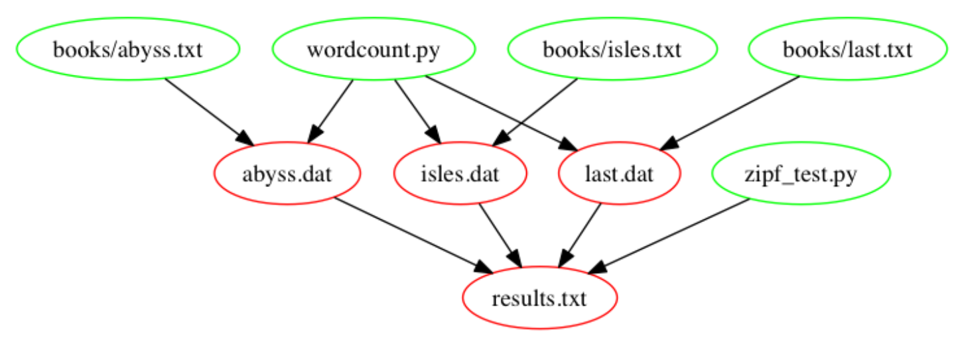
Process, Build Results, Clean the Mess!
countwords.py
testzipf.py

Slide 13
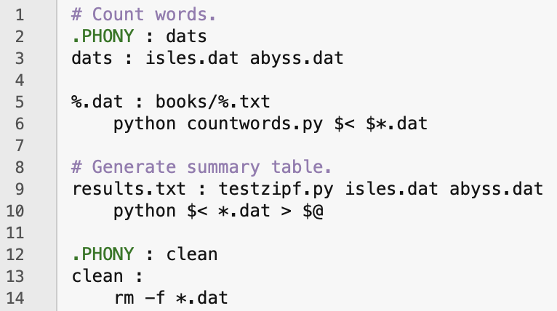
Make: Build Results

Slide 14
GIT
Part II
Tom, because I've always known that your instincts were le imate.

Slide 15
Git: main features
Track all your changes
Work along with others
Share work with others
With Git

Slide 16
Git is a distributed version-control system
You keep your files in a repository on your local machine.
You synchronize your repository with a repository on a server.
If you move from one machine to another, you can pick up the changes by synchronizing with the server.
If someone else on your team uploads some changes to your files, you can pick those up by synchronizing with the server.

Slide 17
Git is a distributed version-control system
Terminology: In git-speak, a “version” is called a “commit.”
Git keeps track of the history of your commits, so you can go back and look at earlier versions, or just give up on the current version and go back some earlier version.

Slide 18
A simple model of git
Most git documentation gets into details very quickly.
Here’s a very simple model of what’s going on in git.

Slide 19
Your files
my-project
docs
README.md
README.html
src
main.py
cleandata.py
EDA.py
ML_models.py
Here are your files, sitting in a directory called my-project

Slide 20
Your files in your git repository
.git
my-project
docs
README.md
README.html
src
main.py
cleandata.py
EDA.py
ML_models.py
When you have a git repository, you have an additional directory called .git, which points at a mini-filesystem.
This file system keeps all your data, plus the bells and whistles that git needs to do its job.
All this sits on your local machine.
Here are your files, sitting in a directory called my-project

Slide 21
The git client
.git
my-project
docs
README.md
README.html
src
main.py
cleandata.py
EDA.py
ML_models.py
This mini-filesystem is highly optimized and very complicated. Don’t try to read it directly.
The job of the git client is to manage this for you.

Slide 22
Your workflow (part 1)
You edit your local files directly.
You can edit, add files, delete files, etc., using whatever tools you like.
This doesn’t change the mini-filesystem, so now your mini-filesystem is behind.

Slide 23
A Commit
.git
my-project
docs
README.md
README.html
src
main.py
cleandata.py
EDA.py
ML_models.py
commit
When you do a “commit”, you record all your local changes into the mini-filesystem.
The mini-filesystem is “append-only”. Nothing is ever over-written there, so everything you ever commit can be recovered.

Slide 24
Synchronizing with the server (1)
your local machine
a server, somewhere on the internet, eg. github.com
.git
push
my-project
docs
README.md
README.html
src
main.py
cleandata.py
EDA.py
ML_models.py
At the end of each work session, you need to save your changes on the server. This is called a “push”.
Now all your data is backed up.
You can retrieve it, on your machine or some other machine.
Your teammates can retrieve it as well

Slide 25
Synchronizing with the server (2)
your local machine
a server, somewhere on the internet, eg. github.com
.git
pull
my-project
docs
README.md
README.html
src
main.py
cleandata.py
EDA.py
ML_models.py
To retrieve your data from the server, you do a “pull”. A “pull” takes the data from the server and puts it both in your local mini-fs and in your ordinary files.
If your local file has changed, git will merge the changes if possible. If it can’t figure out how to the merge, you will get an error message. We’ll talk about this some more a little later in this lesson.
pull

Slide 26
The whole picture
your local machine
pull
a server, somewhere on the internet, eg. github.com
.git
my-project
docs
README.md
README.html
src
main.py
cleandata.py
EDA.py
ML_models.py
push
commit
pull

Slide 27
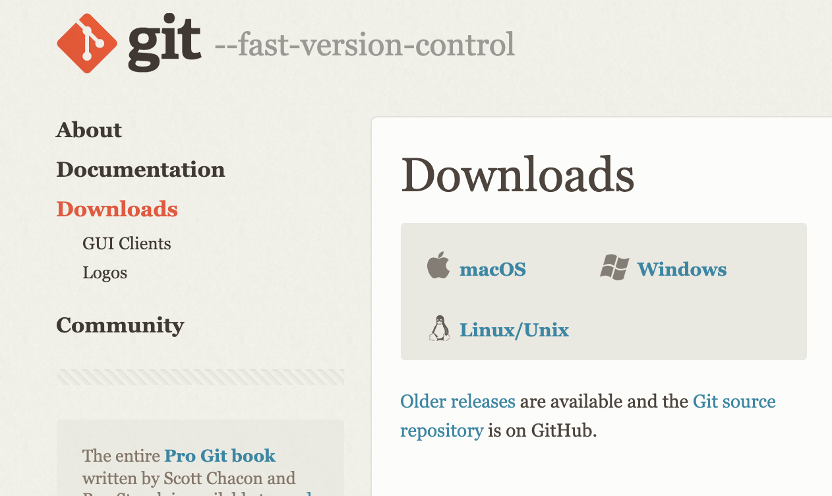
Installing Git
https://git-scm.com/downloads
You can check whether you already have git
You better get the latest version. 1. install homebrew, 2. brew install git
Notes:
GitHub requires getting a token
https://ginnyfahs.medium.com/github-error-authentication-failed-from-command-line-3a545bfd0ca8

Slide 28
Step-1: Basic Configuration
Open a terminal
Tell git your name and email:
git config --global user.name “Your Full Name”
git config --global user.email your_uni@umbc.edu
You can set the default editor, e.g. nano or pico or whatever you have/like
git config --global core.editor nano
git config --global content.editor "pico -w"
You can set main as the default branch name do:
git config --global init.defaultBranch main
You only have to do this once. You can make changes later, if you want
To check the current configuration
git config --list

Slide 29
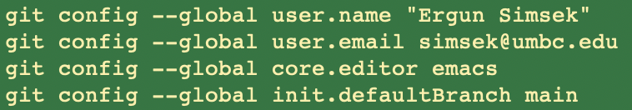
Example
Getting Help
git help <verb>
git <verb> --help
man git-<verb>
For example
git help config

Slide 30
Getting a Git Repository
You typically obtain a Git repository in one of two ways:
You can take a local directory that is currently not under version control, and turn it into a Git repository, or
You can clone an existing Git repository from elsewhere.
In either case, you end up with a Git repository on your local machine, ready for work.
For the first approach, we’ll use
git init - this initiates a git repository in the current folder
May take a while. Check the directory with ls –a
But let’s see the 2nd approach

Slide 31
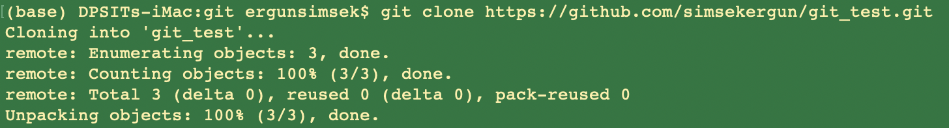
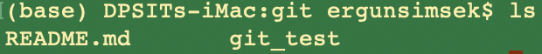
GitHub
In order to have an example, I created an empty repo on my github repo
Even though it is empty, let’s clone it to get a copy
https://github.com/simsekergun/git_test
git clone https://github.com/simsekergun/git_test.git

Slide 32
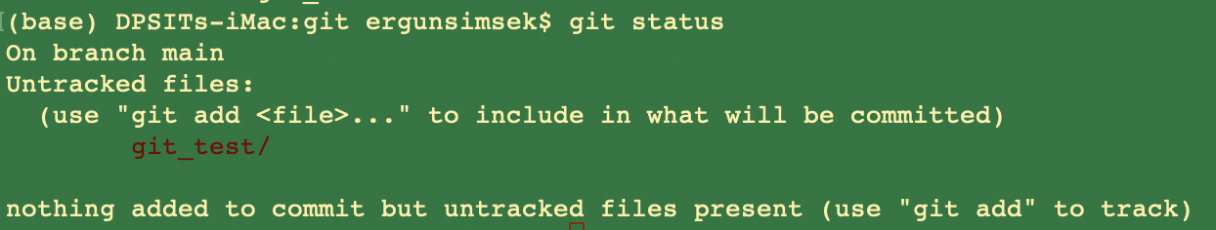
Checking the Status of Your Files
The main tool you use to determine which files are in which state is the git status command. If you run this command directly after a clone, you should see something like this:
This means you have a clean working directory; in other words, none of your tracked files are modified.

Slide 33
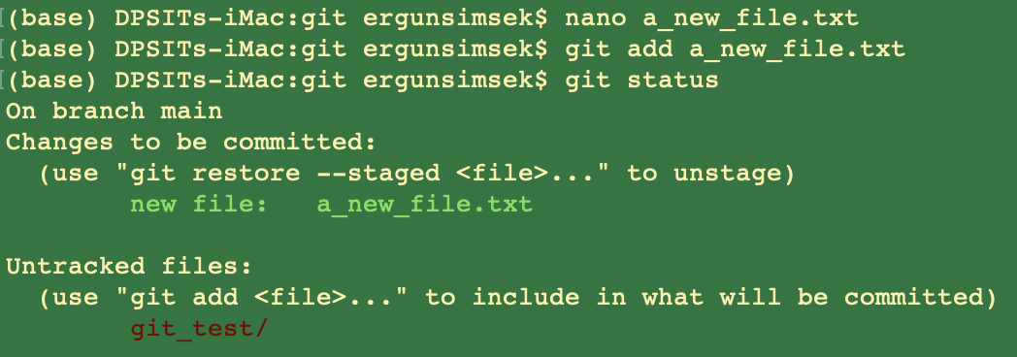
Let’s make a change
Let’s create a new file called “a_new_file.txt”
Then add it to the project

Slide 34
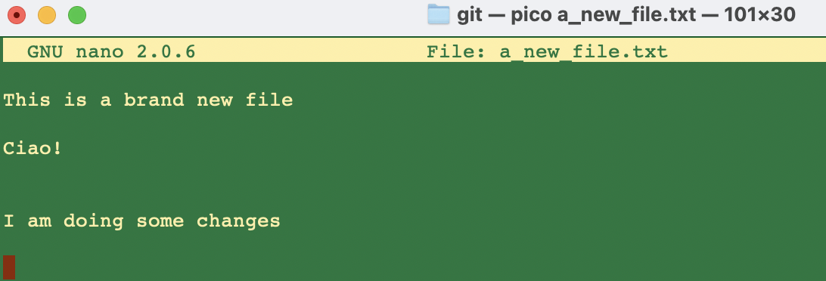
Let’s make some changes

Slide 35
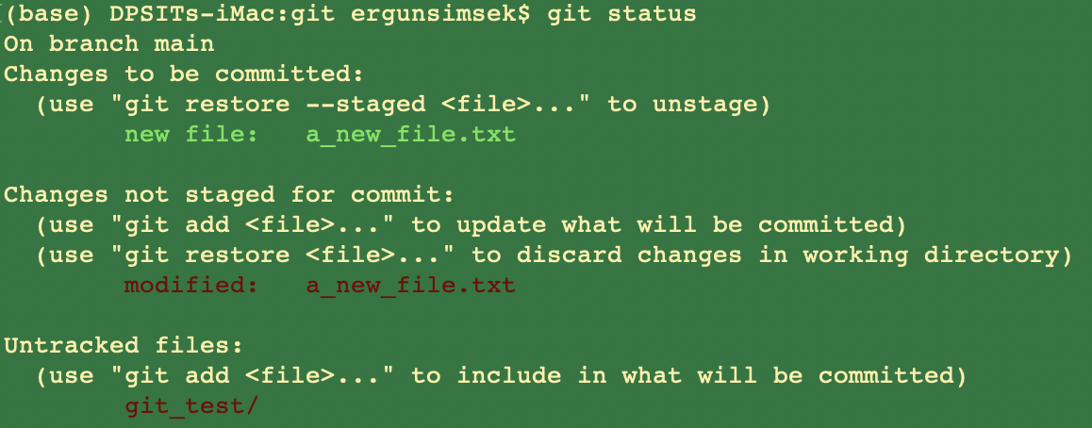
Let’s see what happens to the status

Slide 36
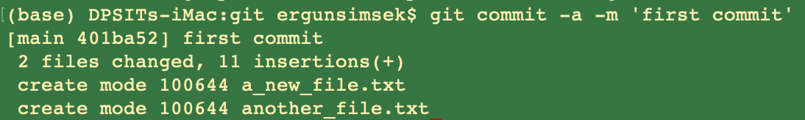
Let’s Commit
git commit -a -m 'first commit'
your personal note here

Slide 37
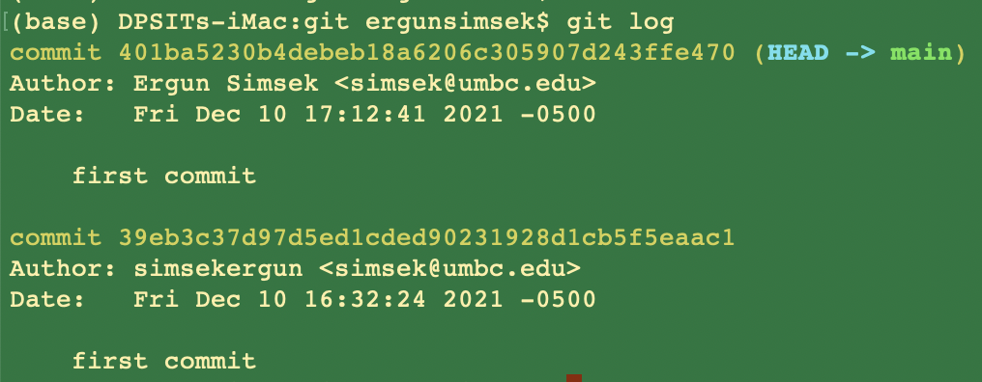
Viewing the Commit History

Slide 38
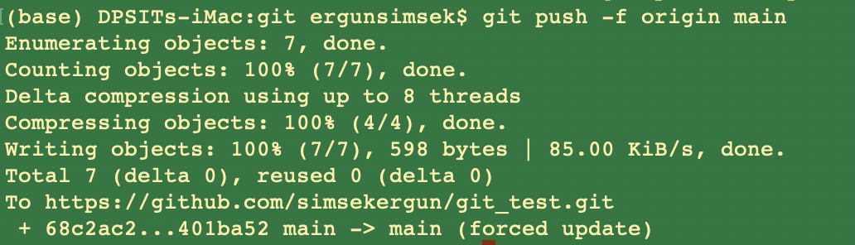
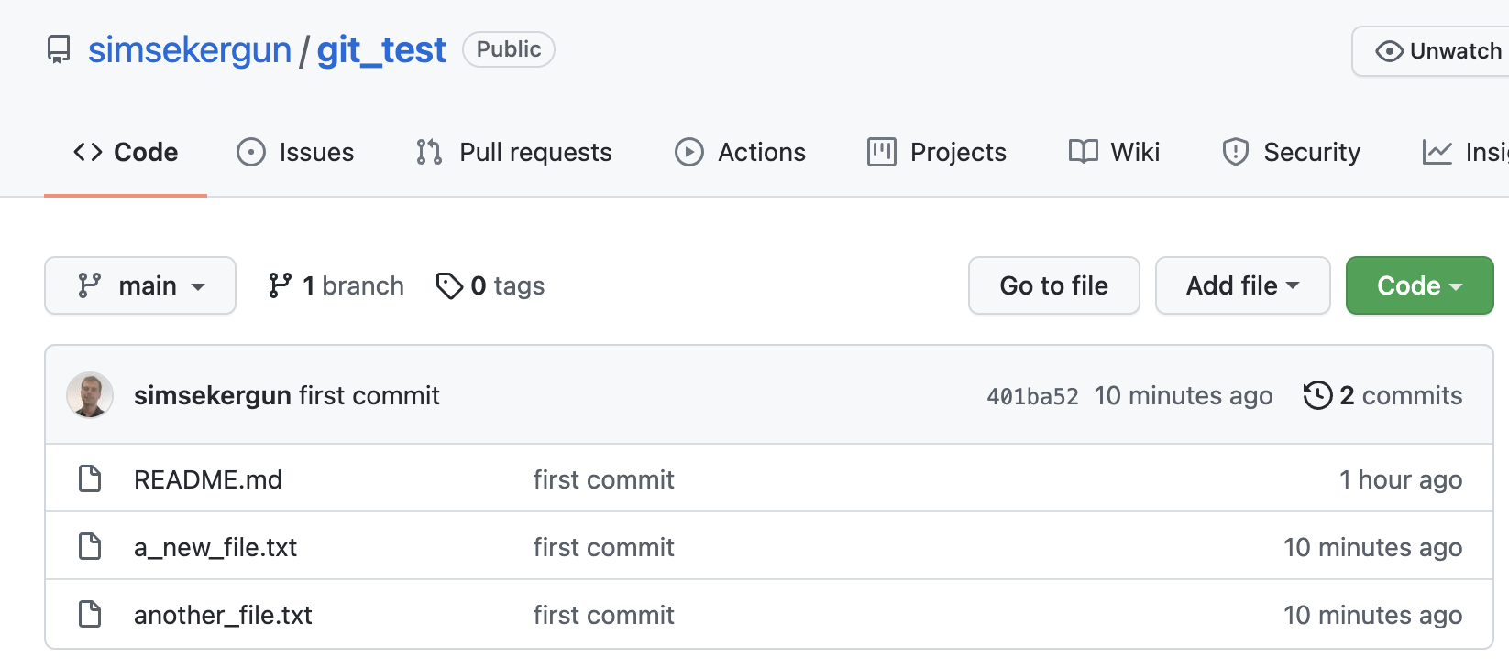
Pushing to Your Remotes
Voilaaaaa!

Slide 39
Git Workflow: New Project
git init <folder_name> (as in tutorial part one)
Local
computer
git add <file_name>
git commit -m “messages”
Github.com

Slide 40
Your workflow over multiple sessions
You pull the latest version of your work from the server
You, maybe on another computer
You
You
pull
pull
pull
edit
edit
edit
commit
commit
commit
edit
server
edit
server
edit
commit
commit
commit
edit
edit
edit
commit
commit
commit
push
push
push
You push your work to the server
You update your-ID-log.txt at the end of each session

Slide 41
Oh no! I’ve got a git conflict
If you update your work before you pull, git will try to merge the changes when you do pull.
If git can’t figure out how to do the merge, it will go into a special mode in which it expects you to resolve the conflicts.
When you have the files the way you want them, you can commit them and continue working. Here’s a guide https://docs.github.com/en/pull-requests/collaborating-with-pull-requests/addressing-merge-conflicts/resolving-a-merge-conflict-using-the-command-line

Slide 42
Branches
Branches are used to develop features isolated from each other.
The master branch is the "default" branch when you create a repository.
Use other branches for development and merge them back to the master branch upon completion.

Slide 43
Branching
create a new branch named "feature_x" and switch to it using
git checkout -b feature_x
switch back to master
git checkout master
and delete the branch again
git branch -d feature_x
a branch is not available to others unless you push the branch to your remote repos
git push origin <branch>
to merge another branch into your active branch (e.g. master), use
git merge <branch>

Slide 44
Other ways to use git and github
There are lots of possible ways to use git and github.
But for core data science courses, you should be able to get by just fine with just a single master branch.
There are many resources, interactive git tutorials on the web.
http://book.git-scm.com/book/en/v2
http://think-like-a-git.net/
Please google it (e.g. git for data science, best git tutorials, etc)
Review as many as possible
And try to implement on your own
KISS principle: “Keep It Simple, Stupid!”

Slide 45
Ethics, Privacy, and DATA SCIENCE
PART III
Just when I though I was out, they pull me back in.

Slide 46


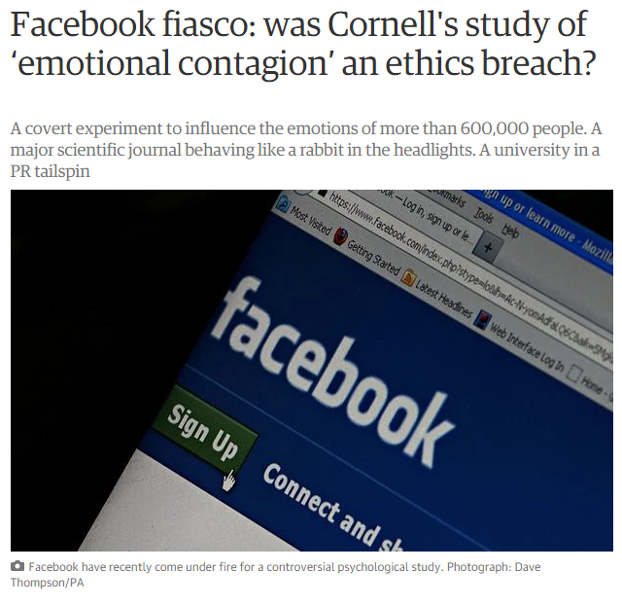
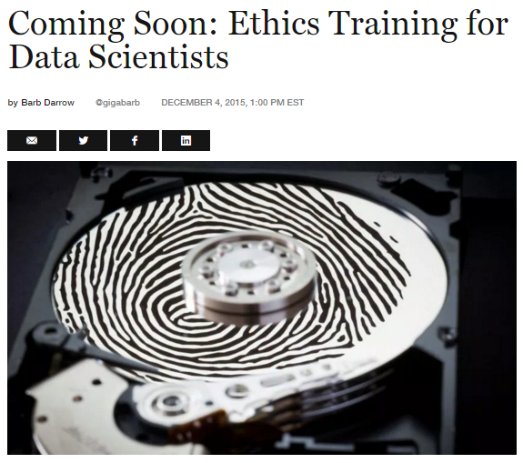
Data Ethics is not a joke!

Slide 47
The Good, the Bad and the Ugly
Increasing efficiency, effectiveness, and competitiveness.
Data driven companies are more productive
Use of data science make the societies more secure
Spam emails, fraud detection, terrorist attacks, shootings etc.
Using AI for Sign Language Translation
Cannyai
Tom Cruise
Barack Obama

Slide 48
Ethics, Privacy, Legal Issues, and DS
Based on the nature of the project, you might see different issues at different stages, e.g. while
Initiating the project
Creating the dataset (e.g. surveying)
Cleaning the dataset
Building the model
Presenting the findings
Sharing with others
…

Slide 49
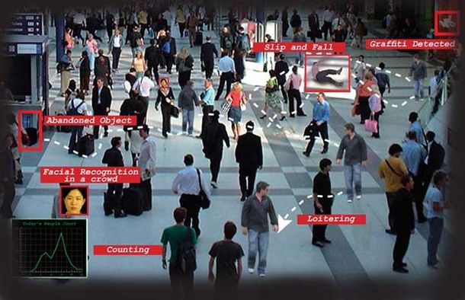
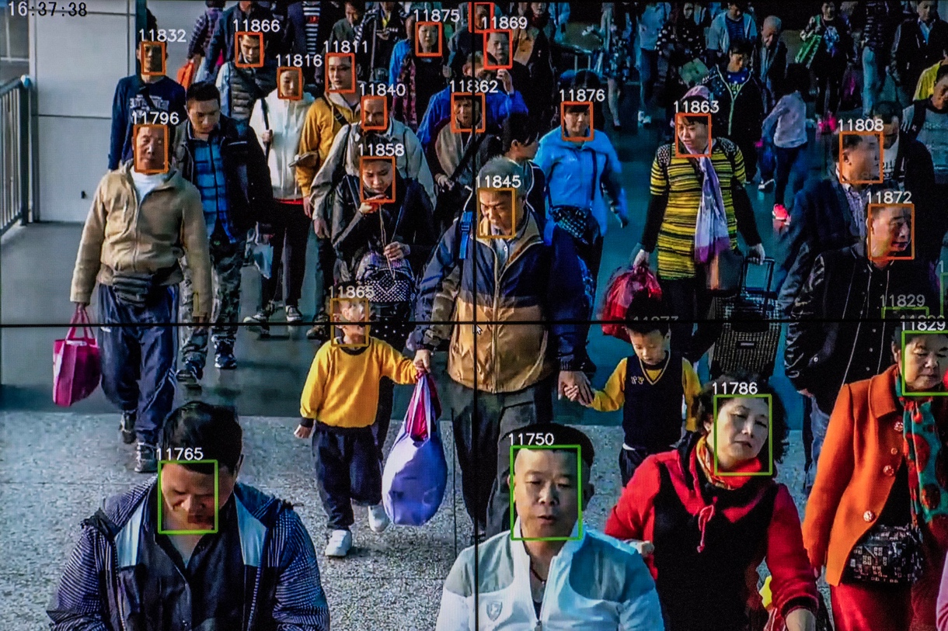
AI Enabled Surveillance
Goal: Determining terrorists
Goal: Catching terrorists, criminals, drug traffickers
What if someone is having a heart attack?
https://www.nytimes.com/2018/07/08/business/china-surveillance-technology.html
Current Use:
Monitoring political activists and minorities
Scoring people
Notes:
@Zhengzhou: A police officer wearing facial recognition glasses spotted a heroin smuggler at a train station.
@Qingdao, cameras powered by artificial intelligence helped the police snatch two dozen criminal suspects in the midst of a big annual beer festival.
@Wuhu, a fugitive murder suspect was identified by a camera as he bought food from a street vendor.

Slide 50
Targeted Marketing - Customized Pricing
Use of personal data increases the effectiveness of the marketing 3-5 times compared to traditional marketing approaches?
Is it win-win or invasion of privacy?
NYT-Target Case
Different Pricing for the same product?

Slide 51
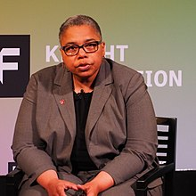
Privacy (Anonymization is the ultimate solution)
Dr. Latanya Arvette Sweeney
In 1997, she identified then MA governor, William Weld, to his medical records using publicly accessible records.
An algo can identify 99.98 percent of Americans from almost any available data set with as few as 15 attributes, such as gender, ZIP code or marital status.
Rocher, L., Hendrickx, J.M. & de Montjoye, YA. Estimating the success of re-identifications in incomplete datasets using generative models. Nat Commun 10, 3069 (2019)
https://www.nytimes.com/2019/07/23/health/data-privacy-protection.html

Slide 52
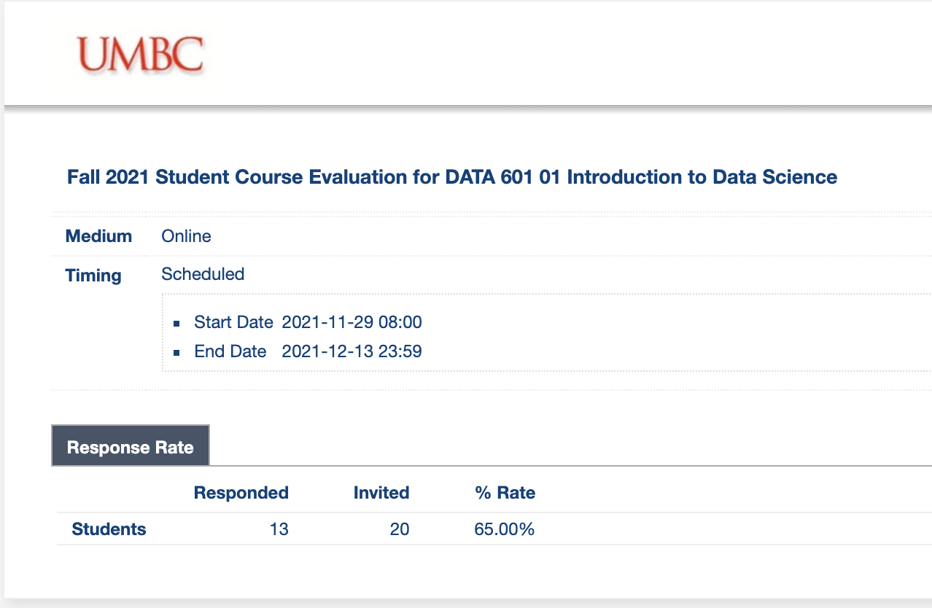
Survey Design is Almost an Art
Population matters
Females more likely to respond than males
Younger generation less likely to join
Questions matter ➔ Next Slides

Slide 53
Survey Design: Questions Matter
A seemingly straight forward question can lead to inaccurate data
The global economy is the most important issue in the world today.
strongly disagree | disagree | neither agree nor disagree | agree | strongly agree
Now look at the revised version
How important is the issue of the global economy in the world today?
not at all Important | slightly important | moderately important | quite important | extremely important

Slide 54
Survey Design: Questions Matter
Providing a reason…
Q8) As some of you may know, the university is debating whether to move some parts of the university to a new section of campus in Rockville. Do you think the university should move to Rockville?
Q8) As some of you may know, the university is debating whether to move some parts of the university to a new section of campus in Rockville. Do you think the university should move to Rockville so that the school can have more space?
Yes = 12.5%
Yes = 55.6%
Giving a reason will improve the extent to which people agree with you, and impact the accuracy of your survey

Slide 55
Survey Design: 7-Step Process
Step 1: Literature Review
Step 2: Interview Experts & Create Focus Groups from Target Population
Step 3: Synthesize
Step 4: Develop Items
Step 5: Expert Validation
Step 6: Cognitive Interviewing
Step 7: Pilot Test

Slide 56
Bias and Fairness
Credit approvals
A.I. Bias Caused 80% Of Black Mortgage Applicants To Be Denied (Link)
Facial recognition
Facial recognition technologies falsely identified Black and Asian faces 10 to 100 times more often than they did white faces (Link)
Criminal justice: recidivism
A computer program spat out a score predicting the likelihood of each committing a future crime. Borden — who is black — was rated a high risk. Prater — who is white — was rated a low risk (Link)
Human resources: resumé screening
AI recruiting tool that showed bias against women (Link)
Healthcare services
Black patients lose out on critical care when systems equate health needs with costs (Link)
https://aiethics.princeton.edu/case-studies/case-study-pdfs/

Slide 57
AI’s Invisibility Problem
Diversity is missing from the data or not considered during development of algorithms resulting in inaccurate predictions for AI involving facial/image recognition for people of color.
Few black people and other people of color working in AI. Black workers represent only 2.5% of Google’s entire workforce and 4% of Facebook’s and Microsoft’s.
Globally, only 22% of AI professionals are female, while 78% are male.

Slide 58
What to do?
Diagnosis by evaluating correlation between explanatory variables (Multicollinearity)
Add more data
Adjust the algorithm
Unbalanced/Skewed Data ➔ Transform
Rare events ➔ Oversample the data (Example)
High frequency events ➔ Undersample the data (Example)

Slide 59
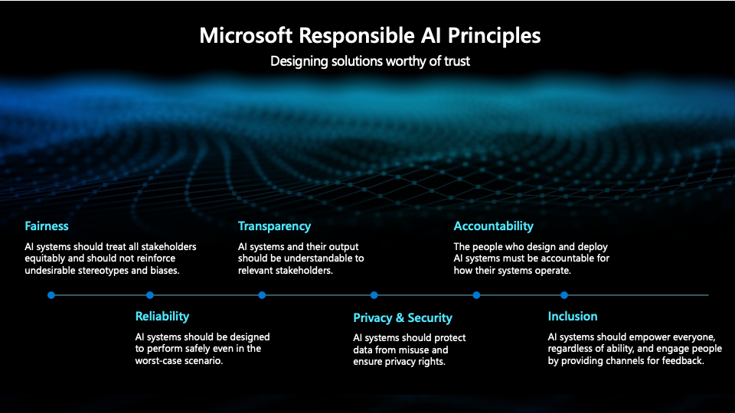

Slide 60
Five C’s
Consent: A clear appreciation and understanding of the facts, implications, and consequences of an action
Clarity: Who is going to use the data, when your data will be used, how long it will be kept, whether it will be shared with 3rd parties?)
Consistency: How will be data stored? What will happen if stolen? Will company choose values when it comes to chose between values and money?
Control: Who has the control over the data? Will the participants be able to change/remove their data?
Consequences: Unknown unknowns: whether a company invest on thinking possible consequences?

Slide 61
Check-list for DS Projects
Have we listed how this technology can be attacked or abused?
Have we tested our training data to ensure it is fair and representative?
Have we studied and understood possible sources of bias in our data?
Does our team reflect diversity of opinions, backgrounds, and kinds of thought?
What kind of user consent do we need to collect to use the data?
Do we have a mechanism for gathering consent from users?

Slide 62
Check-list, Cont.
Have we explained clearly what users are consenting to?
Do we have a mechanism for redress if people are harmed by the results?
Can we shut down this software in production if it is behaving badly?
Have we tested for fairness with respect to different user groups?
Have we tested for disparate error rates among different user groups?
Do we test and monitor for model drift to ensure our software remains fair over time?
Do we have a plan to protect and secure user data?

Slide 63
Charts can be misleading
Well-designed charts are empowering.
They can also deceive viewers regardless of whether they are designed with ill-intent or not.
Data visualization has ethical consequences
Ethical thinking is not only about intentions, but also about consequences.

Slide 64
Ethical Principles of Data Visualization
Need to explicitly consider ethical principles when creating and distributing visualizations.
Transparency
Integrity
Accountability

Slide 65
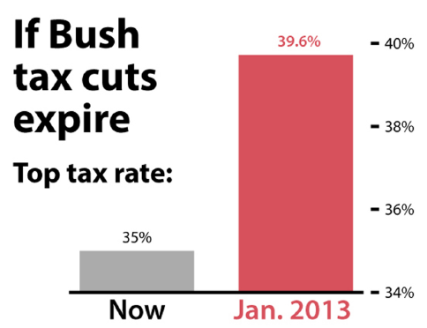
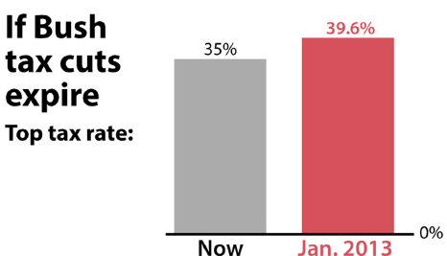
Don’t
It should have been
Notes:
Fox News, 2012

Slide 66
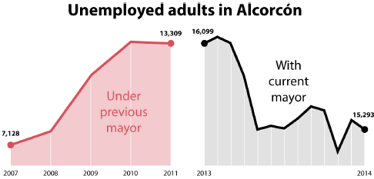
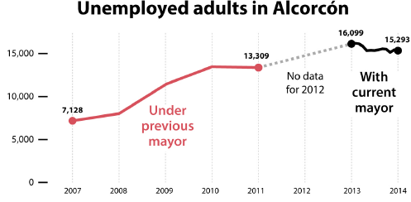
Don’t
Created by the Spanish city of Alcorcon in 2014 to celebrate the success of the current Mayor in increasing employment.
Distorted both vertical and horizontal scales.

Slide 67

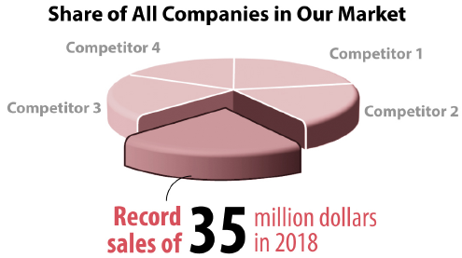
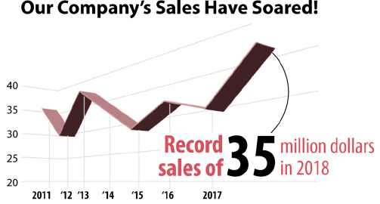
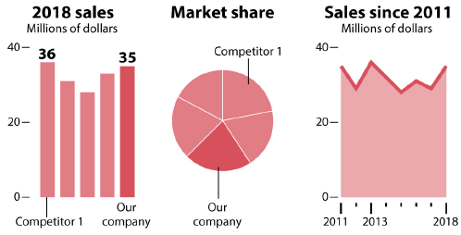
Don’t

Slide 68
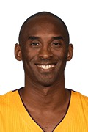


Was Kobe a ball hog?
In the 2009-2010 season, Kobe made 9.8 shots per game and had 5.0 assists per game, on average.
10
10
5
5
Made Shots
Assists
Made Shots
Assists
Notes:
This pictograph is misleading. While the number of ‘made shots’ is only double the ‘assists’ per game, the two-dimensional ball figure makes the made shots appear several times as big.

Slide 69
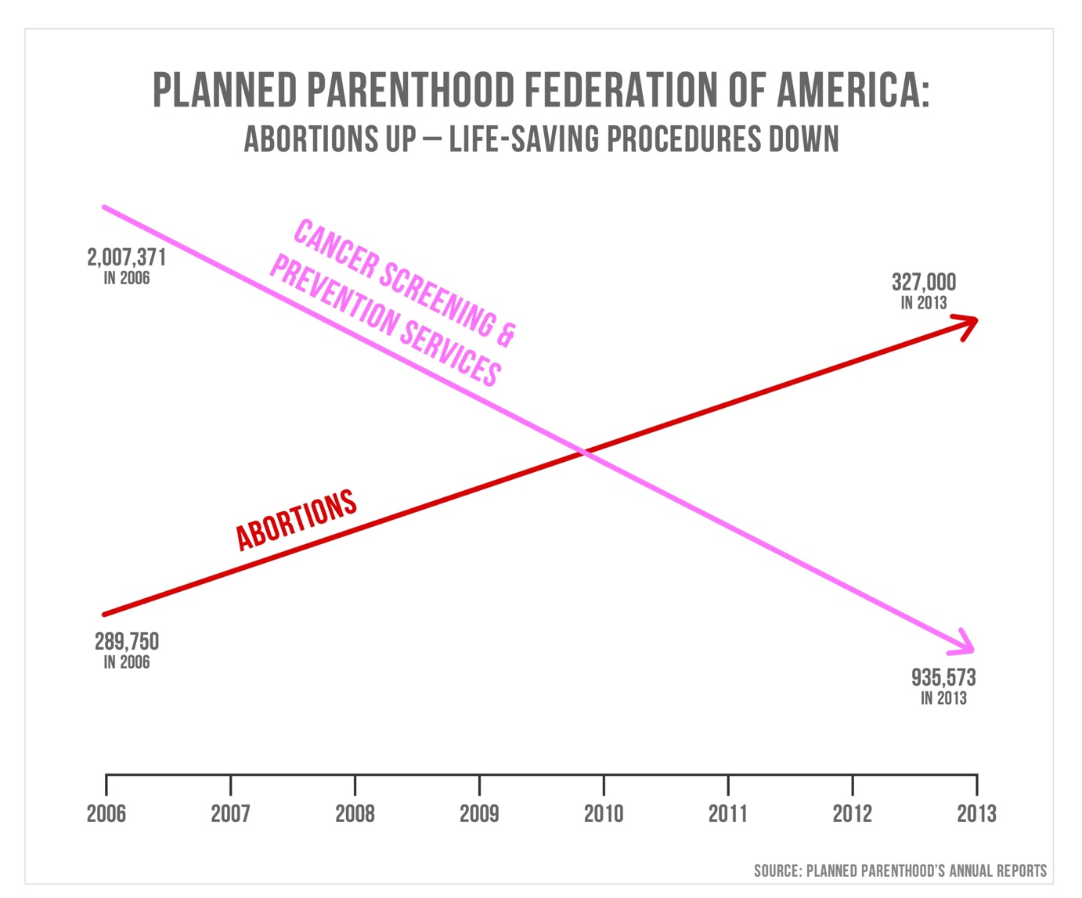
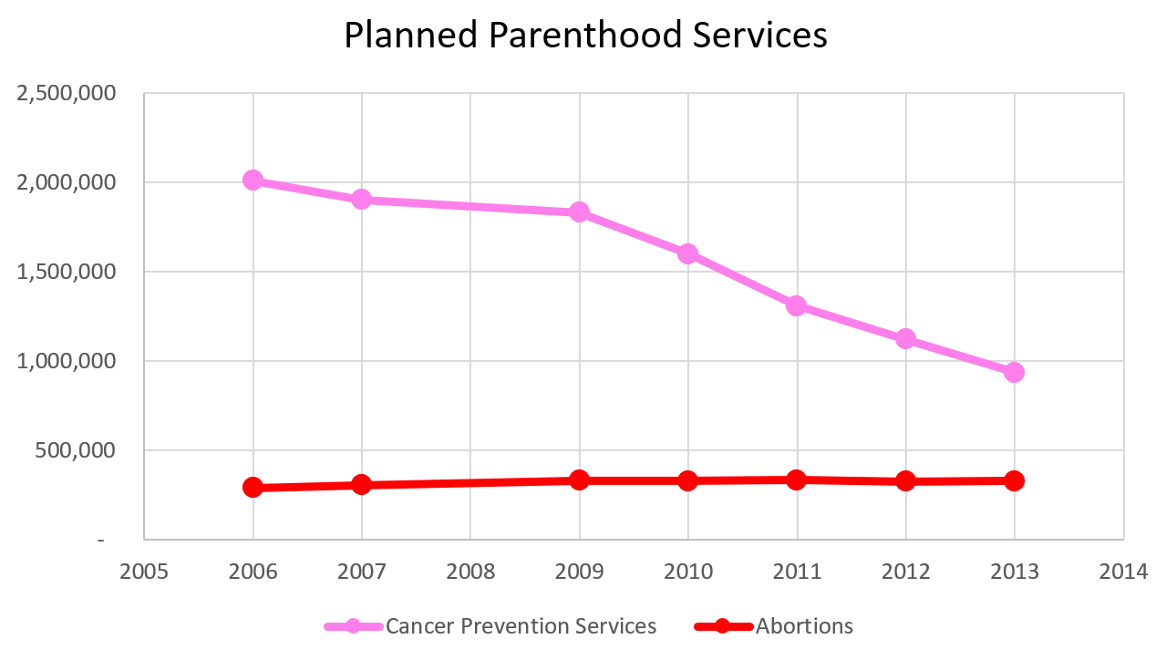

Slide 70
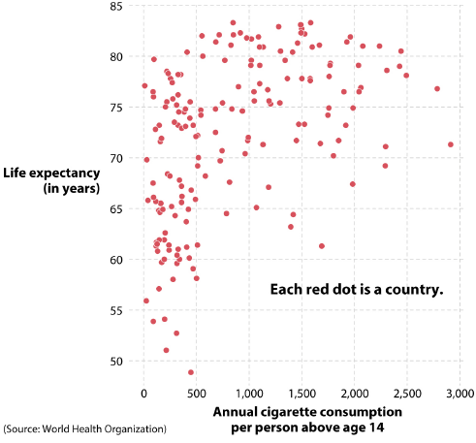
Correlation is not equal to causation
The more cigarettes we consume, the longer we live!!!

Slide 71
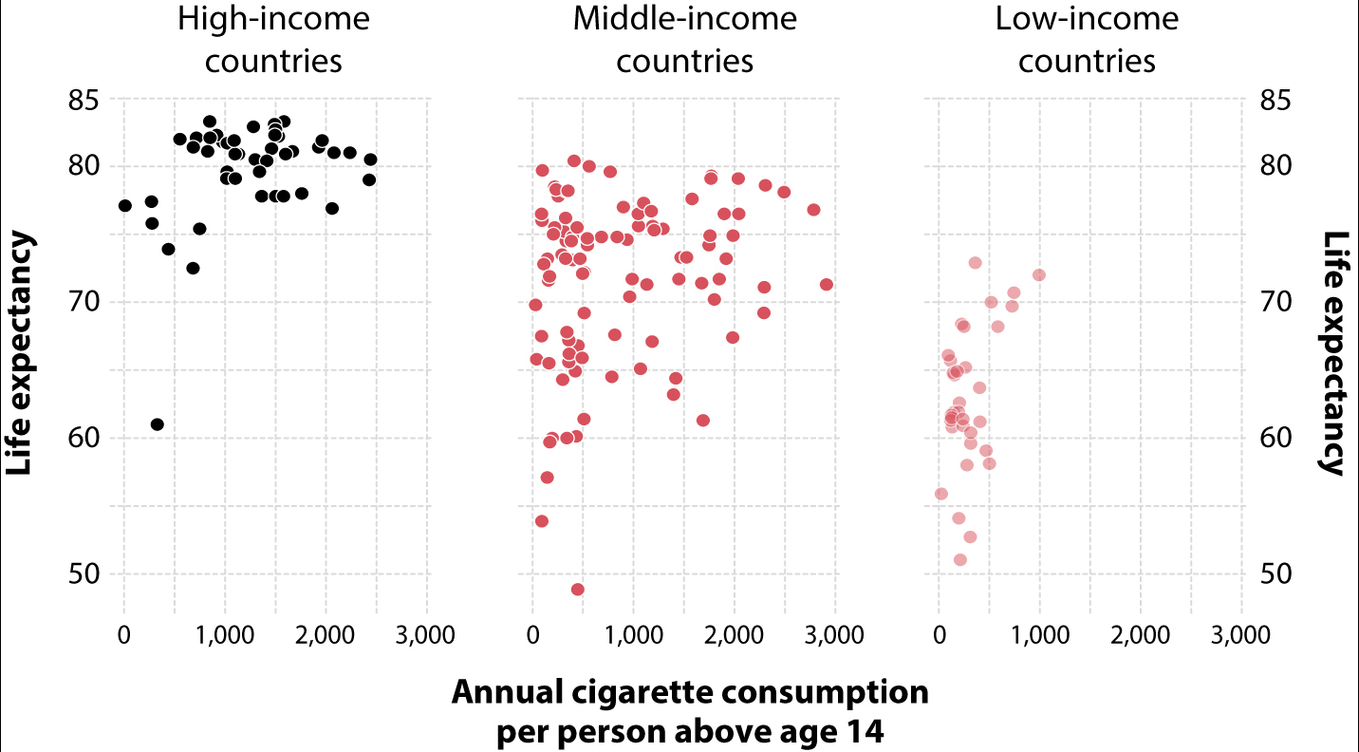
Correlation is not equal to causation

Slide 72
Before You Create a Chart
Ask
Who is my audience?
What questions do they have?
What answers am I finding for them?
What am I trying to say?
What other questions will my visualization inspire or what conversations may result?

Slide 73
Data Visualization Best Practices
Identify your target audience
Make sure your data is clean
Select the right chart
Label your chart effectively
Emphasize the important points
Format your chart for accessibility
Make use of color
Ensure your data is readable in any format
Ask for feedback

Slide 74
Last Words: The CRAPPY Method
Code
Read
Appear
Plan
Participate
Yelp

Slide 75
Whom to Follow on Twitter
Edward Raff @EdwardRaffML
Maithra Raghu @maithra_raghu
François Chollet @fchollet
Sara Hooker @sarahookr
Ian Goodfellow @goodfellow_ian
Been Kim @_beenkim
Andrew Ng @AndrewYNg
Hanie Sedghi @HanieSedghi
Sebastian Raschka @rasbt

Slide 76
FEEDBACK PLEASE
https://forms.gle/RJCStnw3yHJwWBDNA

Slide 77
THANK YOU
Happy Holidays

